Slide 1
Data acquisition and analysis of Chalmers Power Central
User story and implementation outlook
Renesteban Forero Franco & Isabel Cañete Vela
PhD students – Thermochemical recycling of Plastics
Energy Technology

Slide 2
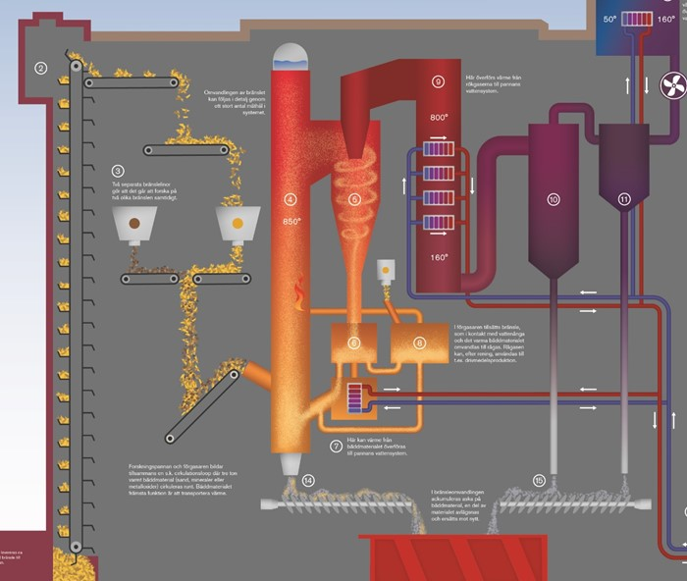
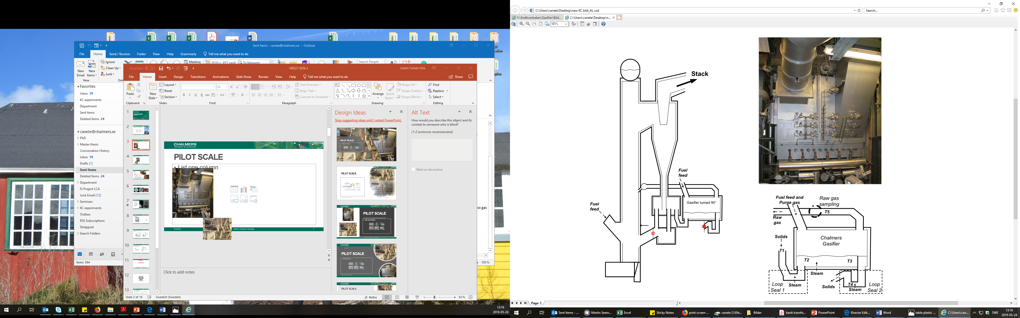
User need
Measurements
Everything…
T,P, flows
Gas composition
Others
Massive data handling
Retrieve many sources
Different formats
Manual data handling

Slide 3
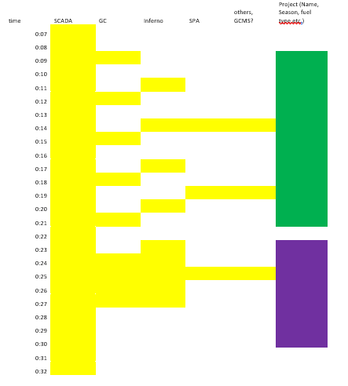
Class defintion
Project 1
Season 1
Experiment 1
Experiment 2
Season 2
Experiment 1
Point 1
Point 2
Point 1
Point 1
Point 2
Point3
“The Concept” Table

Slide 4
Project
project_name project_description project_responsible date_ini date_end bed_type fuel_type seasons project_route
def modify_Project_attributes def add_Season def delete_Season def transfers_Season def get_dates_total def get_fuel_total def get_numberprojects def modify_numberprojects
Season
season_name season_description date_ini date_end bed_type fuel_type experiments season_route
def modify_Season_attributes def add_Experiment def delete_experiment def transfers_experiment def get_dates_global def get_fuel_total
Experiment
(timeinterval) exp_name bed_type fuel_type exp_comments data_experiment data_experiment_info exp_route
def modify_Exp_attributes def add_Point def add_data def add_data_fromfile def get_dates_db def get_dbnames def add_dbtype
Point
point_name point_comments date_ini date_end data_added point_route
def set_point_data def update_db_global
Timeinterval
Date_ini Date_end
(no functions)

Slide 5
Class example
Date start
Experiment X
Date End
SCADA
The times are taken from the class directly
Fuel Type
GC1
Intervals must to be defined
In the case that several GC were taken within the same experiment interval date, other intervals must to added to create a list
Description/comments
Inferno
SPA
Each sheet must to be assign manually (just for now) to a specific hour.
Data

Slide 6
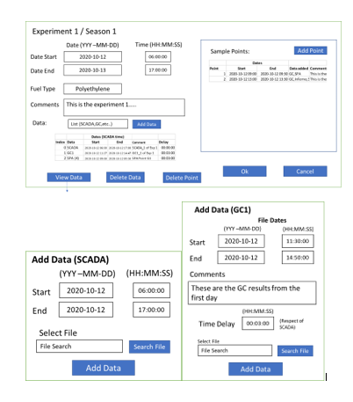
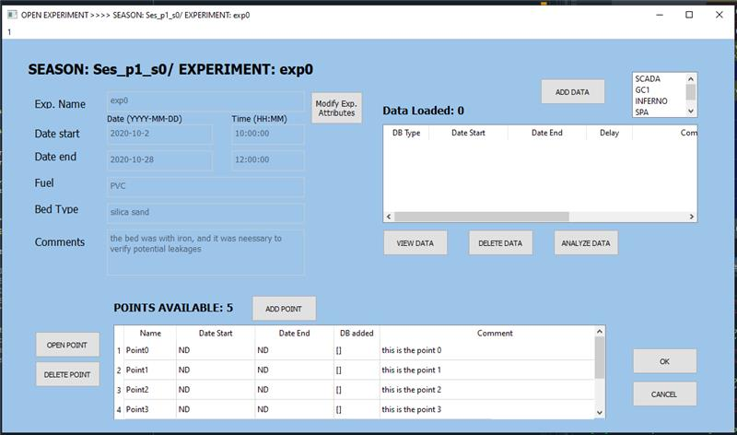
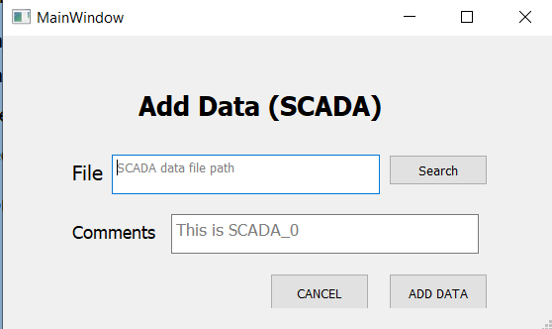

From idea to implementation

Slide 7
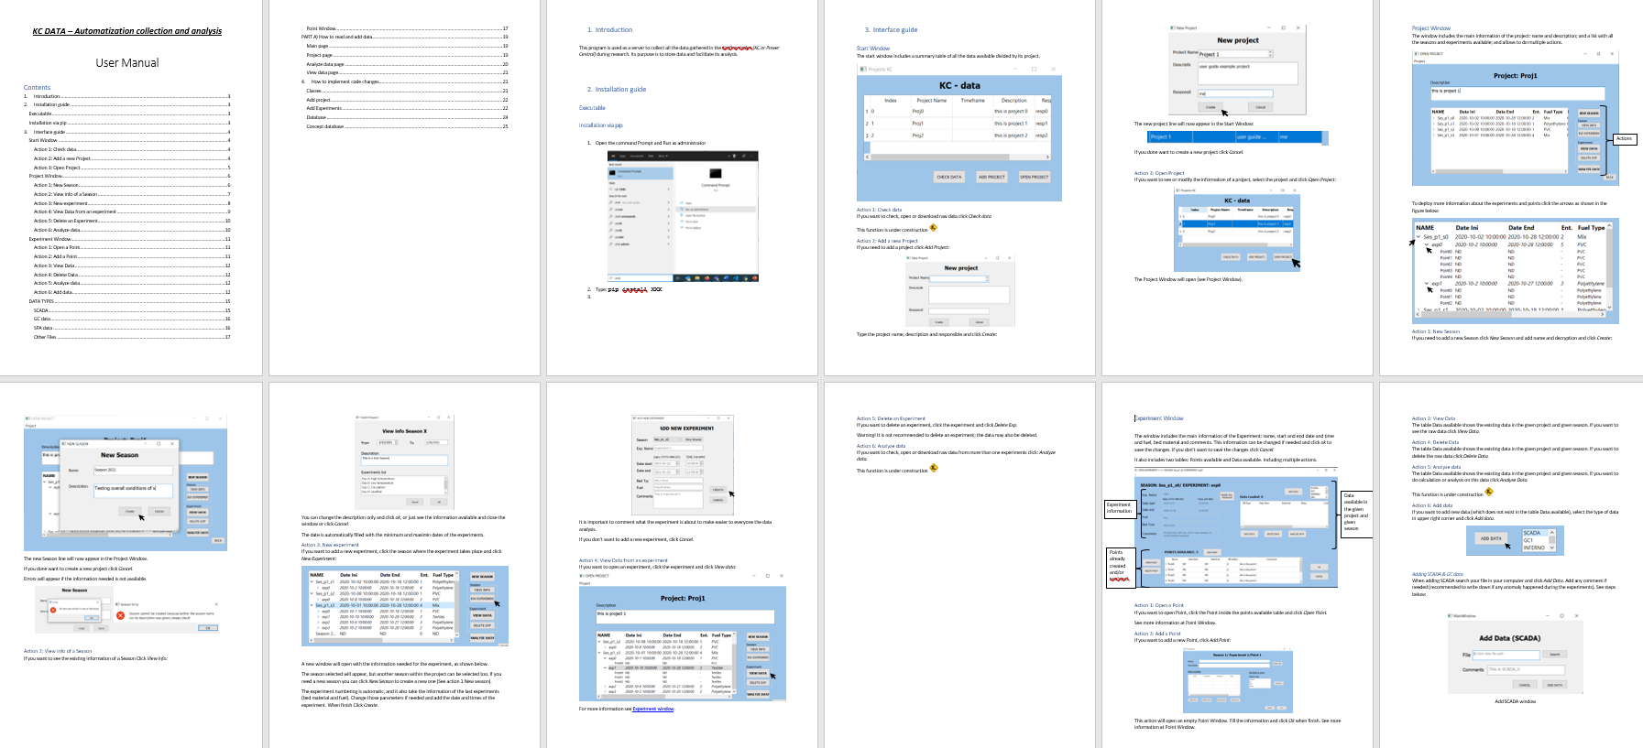
User guide

Slide 8
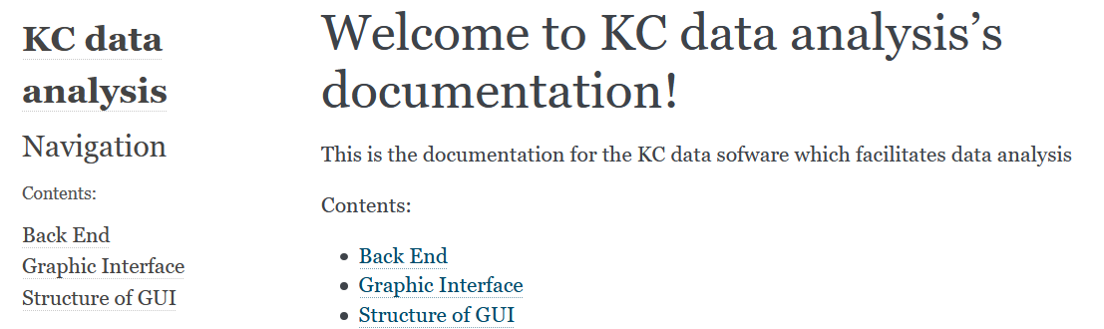
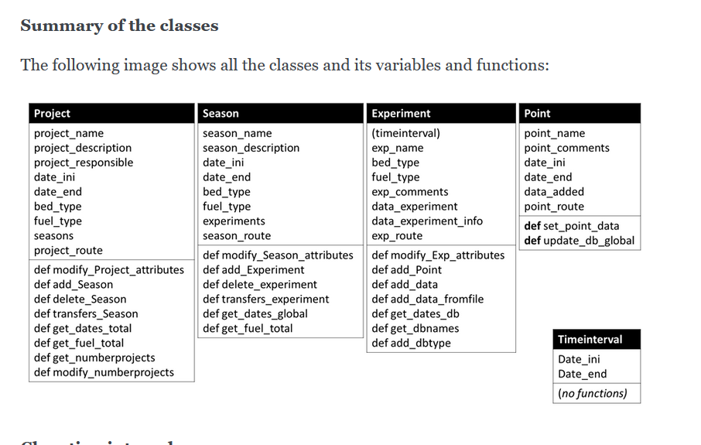
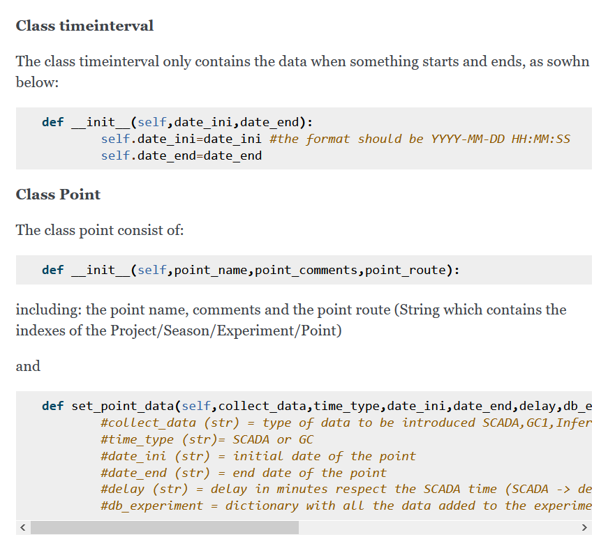
Docs

Slide 9
Show Case

Slide 10
Final retrospective- Reflections
Work organization
Rene: Back End and Linking
Isabel: Front End and documentation
Tools
Github
Qt5 Designer
Sphinx
Collaboration
Good, maybe time planning could go better
Problem Definition
Functions and/or Classes Implementation
Final User-Experience considerations and Data processing optimization
Python Package Compilation
Final Release
Setting up GitHub Repository
Program design & data manag.
Notes:
A backlog is a list of tasks required to support a larger strategic plan. In a product development context, it contains a prioritized list of items that the team has agreed to work on next. Typical items on a product backlog include user stories, changes to existing functionality, and bug fixes.
One key component that gives a backlog meaning is that its items are ordered by priority. The items ranked highest on the list represent the most important or urgent items for the team to complete.

Slide 11



Slide 12
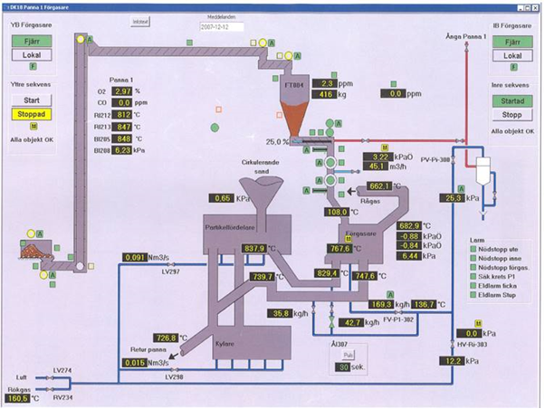
SCADA – operation data 24hrs (every 1 min)
Notes:
Snapshot of the data (SCADA data

Slide 13
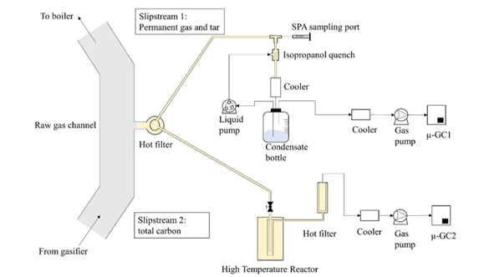
Measurament Data - Short Time Frame
Gas data 1&2
(8h/day every 3 min)
’Liquid’ data (manual -
4 data sets per point,
long analysis time)

